Slide 1
AN EFFICIENT DETECTION OF FETAL BRAIN ABNORMALITIES USING CONVOLUTION NEURAL NETWORK(CNN)

Slide 2
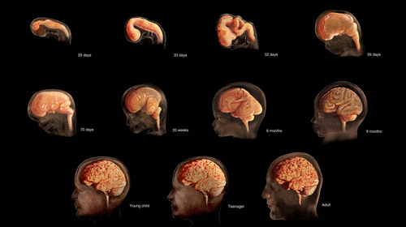
INTRODUCTION
Human brain development starts soon after conception and continues into early adulthood. The fetal brain begins to develop during the third week of gestation.
Currently, neoteric and non invasive tool used for monitoring fetal brain.
Identification and classification of fetal brain development from fetal MRI images at an each stage.

Slide 3
OBJECTIVE
The main objective of this project used to detect the fetal brain condition during scanning process itself and know about brain development stages of the Womb.
To know about health of baby in the womb and perform respective function.

Slide 4
ABSTRACT
Detecting of fetal brain and classifying fetal brain development stages from magnetic resonance imaging (MRI) image datasets, as approximately 3 stages of pregnant women with reliable accurate fetal monitoring.
To classify fetal brain stages in very early age is for preterm infants and neonates not fetal.
Development stages classification using deep learning techniques can helps to improve the quality of diagnosis and treatment planning.

Slide 5
LITERATURE SURVEY
TITLE OF THE PAPER. | NAME OF THE JOURNAL,VOL.NO. & YEAR | METHODOLOGY | LIMITATIONS/ FUTURE SCOPE
1. AUTOMATIC MEASUREMENT OF THALAMIC DIAMETER IN 2-D FETAL ULTRASOUND BRAIN IMAGES USING SHAPE PRIOR CONSTRAINED REGULARIZED LEVEL SETS | IEEE JOURNAL , IEEE JOURNAL OF BIOMEDICAL AND HEALTH INFORMATICS, Volume: 21 , Issue: 4 , July 2017 | A part of computer-assisted screening tools that automatically measure the biometrics of the fetal thalamus. | Lower level features are taken and does not cover whole neurodevelopment.
2. FETAL ULTRASOUND IMAGE QUALITY ASSESSMENT WITH DEEP CONVOLUTIONAL NETWORKS. | IEEE TRANSACTIONS ON CYBERNETICS , VOLUME: 47 , ISSUE: 5 , MAY 2017. | An automatic method for brain tissue segmentation in fetal MRI into seven tissue classes using convolutional neural networks. | In these system, to increase the dataset with more accuracy.
3. AN AUTOMATED LOCALIZATION, SEGMENTATION AND RECONSTRUCTION FRAMEWORK FOR FETAL BRAIN MRI | SPRINGER JOURNAL , MEDICAL IMAGE COMPUTING, JUNE 2018 | Propose a fully automatic framework for fetal brain reconstruction that consists of stages. Brain localization based on Convolutional Neural Network (CNN). | To unlocks the use of automatic fetal brain segmentation when irregular state.

Slide 6
EXISTING SYSTEM
To identify tissue in the fetal brain and detects the abnormalities on it. CNN is used to segments the brain whether there is normal or abnormal condition.
The results reveal that importantly, deep learning models are only suitable for the detection of early stage fetal brain injury.

Slide 7
ADVANTAGES
Low complexity and better features discrimination
Better classification accuracy
DISADVANTAGES
Difficult to get accurate results
Not applicable for multiple images for Tumor detection in a short time
Medical Resonance images contain a noise caused by operator performance which can lead to serious inaccuracies classification

Slide 8
PROPOSED SYSTEM
In this proposed system , a pipeline process is proposed for Fetal Brain Development Stages (FBDSC) which uses transfer learning techniques.
In these system designed to classify the stages of fetal brain from the dataset images with the help of classification system.
In order to improve detection accuracy, classification of 3T scanned MRI images based on convolutional neural network (CNN).

Slide 9
METHODOLOGY
Load the Dataset.
Load the model.
Load the training images with argumentation.
Load the test image.
Pre-processing of input image.
CNN Classification of Normal/Abnormal Condition with stages identification.

Slide 10
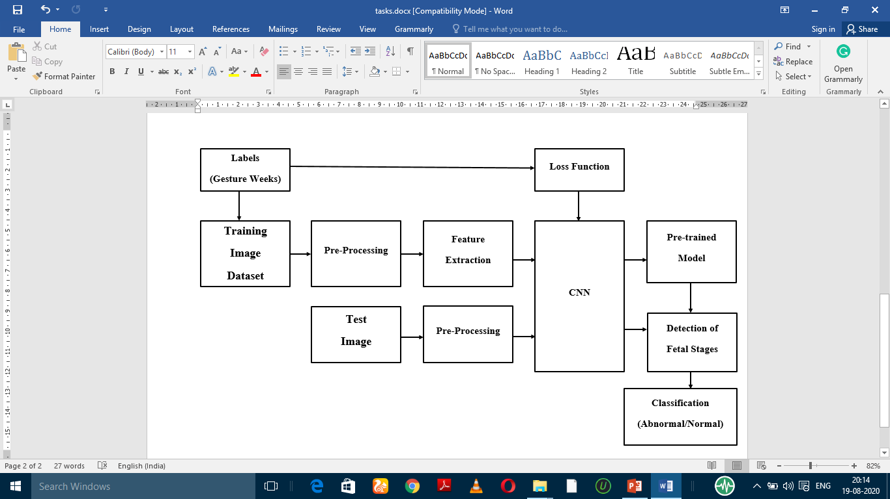
SYSTEM ARCHITECTURE

Slide 11
MODULES
MODULE 1- DATASET COLLECTION
MODULE 2- DATA ARGUMENTATION
MODULE 3- PREPROCESSING
MODULE 4- CLASSIFICATION

Slide 12
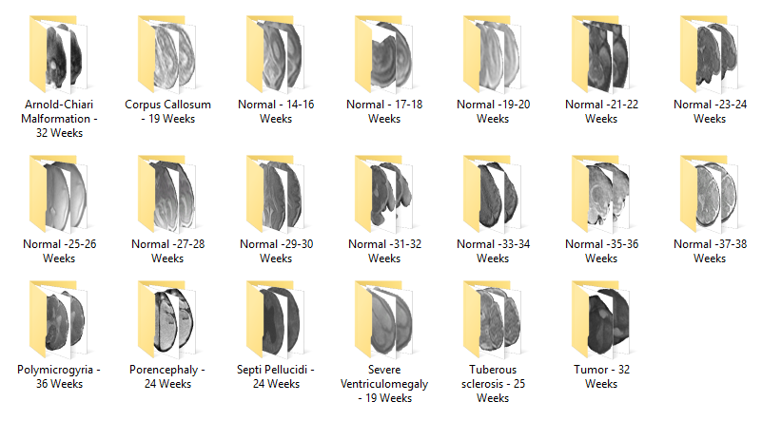
MODULE DESCRIPTION- DATASET COLLECTION
Collection of Fetal brain development Datasets contains Segmented of 3T scanned MRI images.
Abnormal conditions are Arnold-Chiari, Polymicrogyria , Porencephaly, Septi Pellucidi , Corpus Callosum , Tuberous sclerosis and Tumor.
Normal and Abnormal Fetal Images Database based on Weekwise

Slide 13
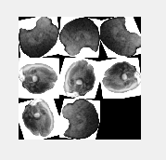
DATA ARGUMENTATION
Data Augmentation encompasses a suite of techniques that enhance the size and quality of training datasets such that better Deep Learning models can be built using them.
Data Augmentation can improve the performance of their models and expand limited datasets to take advantage of the capabilities of big data.

Slide 14
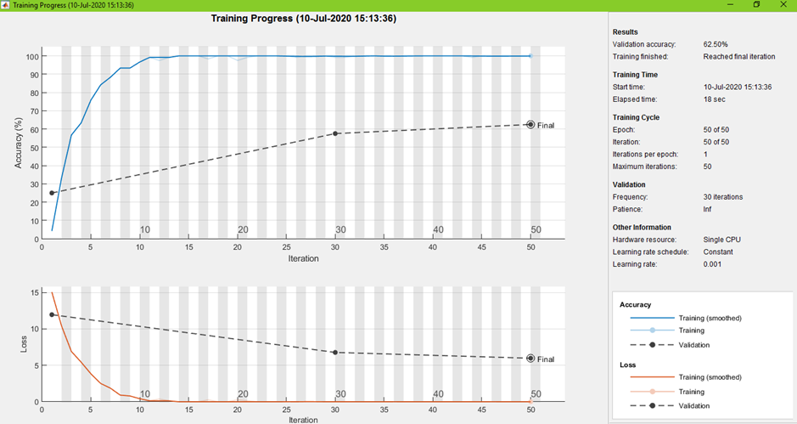
TRAINING OF MODEL

Slide 15
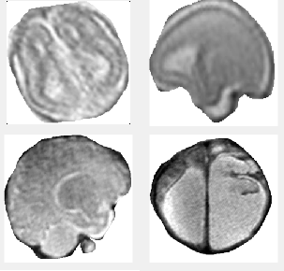
PRE-PROCESSING
Pre-processing operations are applied on input data image for smoothening.
Noise removal process will be used to enhance range of fetal brain region by removing the unwanted pixels from outside region of the image.
These morphological operations are performed on increase accuracy of feature extraction.

Slide 16
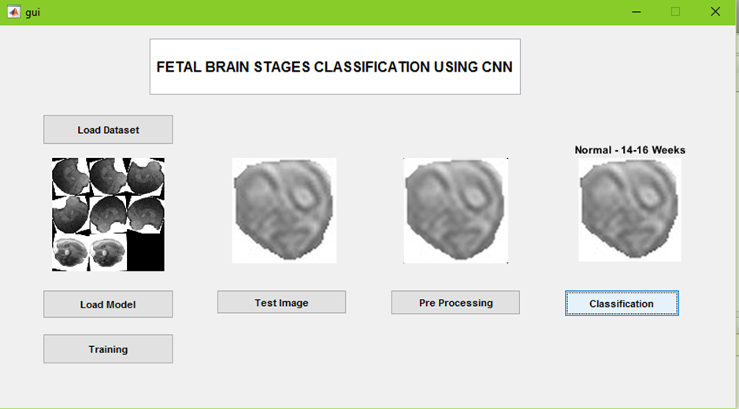
CLASSIFICATION RESULTS

Slide 17
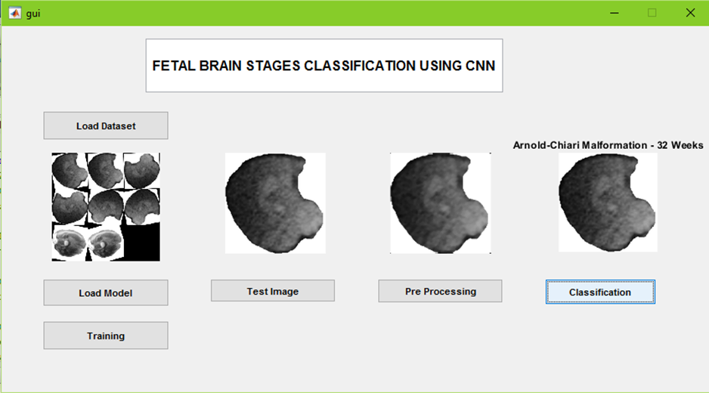
CLASSIFICATION RESULTS

Slide 18
PARAMETERS OF MODEL
Image Classification Algorithm : CNN
Architecture Used on CNN : GoogleNet
Epochs for Training : 10,20,50 Epochs
Learning Rate : 0.001
Optimiser : Adam

Slide 19
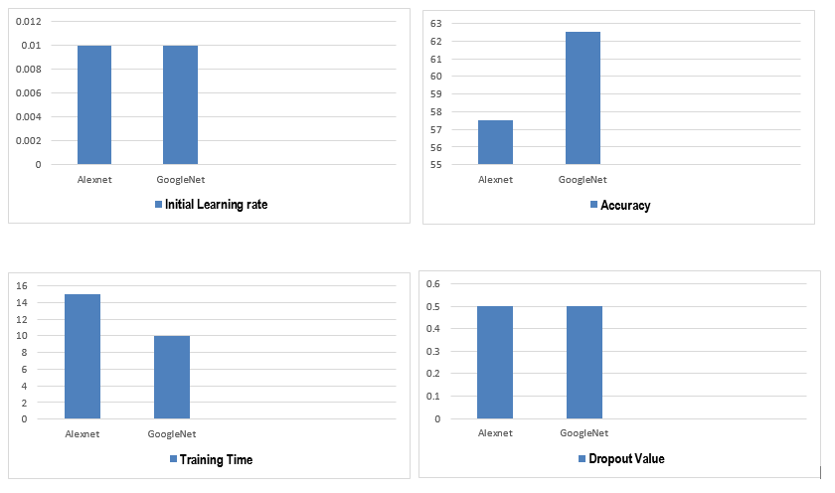
RESULT ANALYSIS

Slide 20
SAMPLE CODE
gui_Singleton = 1; gui_State = struct('gui_Name', mfilename, ... 'gui_Singleton', gui_Singleton, ... 'gui_OpeningFcn', @gui_OpeningFcn, ... 'gui_OutputFcn', @gui_OutputFcn, ... 'gui_LayoutFcn', [] , ... 'gui_Callback', []); if nargin && ischar(varargin{1}) gui_State.gui_Callback = str2func(varargin{1}); end if nargout [varargout{1:nargout}] = gui_mainfcn(gui_State, varargin{:}); else gui_mainfcn(gui_State, varargin{:}); end

Slide 21
handles.output = hObject; a=ones([256 256]); axes(handles.axes1); imshow(a); axes(handles.axes2); imshow(a); axes(handles.axes3); imshow(a);

Slide 22
global layers disp('Pre-Trained Model Loaded...') net = googlenet; layers = [ imageInputLayer([120 120 3]) net(2:end-3) fullyConnectedLayer(20) softmaxLayer classificationLayer() ] msgbox('Pre-Trained Model Loaded Successfully')

Slide 23
global opt training train layers opt = trainingOptions('adam','Maxepoch',20,'InitialLearnRate', 0.001,'Verbose', true, 'Plots','training-progress') training = trainNetwork(train,layers,opt); msgbox('Trained Completed') % Update handles structure guidata(hObject, handles);

Slide 24
global inp cd input [file path] = uigetfile('*.bmp;*.png;*.jpg','Pick an Image File'); if isequal(file,0) warndlg('File not selected'); else inp = imread(file); cd .. axes(handles.axes1); imshow(inp); img=inp; if size(inp,3)>1 Freg = rgb2gray(inp); end handles.img=img; end

Slide 25
global inp J img = rgb2gray(inp); J = medfilt2(img); axes(handles.axes2); title('Filtered Image'); imshow(J); % Update handles structure guidata(hObject, handles);

Slide 26
global training inp out out = classify(training,inp); axes(handles.axes3); imshow(inp); title(string(out)); % Update handles structure guidata(hObject, handles);

Slide 27
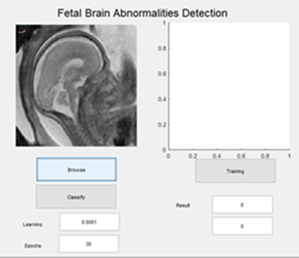
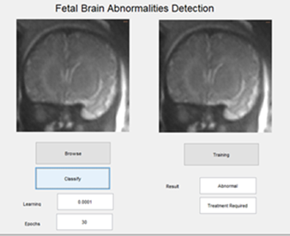
OUTPUT

Slide 28
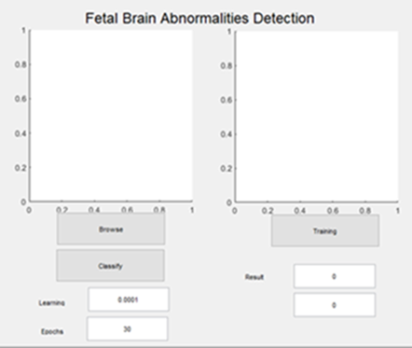
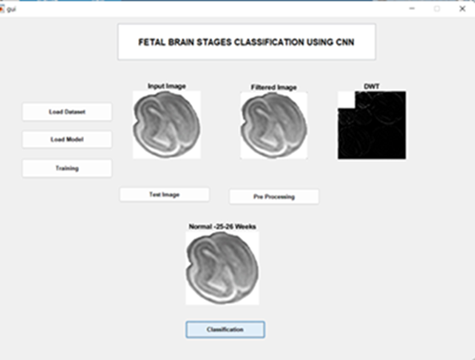

Slide 29
SYSTEM REQUIREMENTS
HARDWARE REQUIREMENT
Processor Type - Pentium -IV
Speed -2.4 GHZ
Ram - 4 GB
Hard disk -20 GB HD

Slide 30
SOFTWARE REQUIREMENT
Operating System - Windows 7
Software Programming Package - MATLAB R2020b

Slide 31
FUTURE ENCHANCEMENT
There are opportunities for further improvement for this project from both technical and clinical point of view.
For instance, on the technical side, adding segmentation constrain to the method when it goes to abnormal condition.
Also extend work for various pre trained network model for providing optimum results. Furthermore, training and testing on rigidly aligned images might provide more accurate localization.
In clinical application, this proposed method will help the patients can easily understand fetal brain development to see uterus fetal brain images.

Slide 32
REFERENCES
Pradeeba Sridar, Joyce Woo , Ann Quinton, Ron Benzie , Michael J. Peek , Automatic Measurement of Thalamic Diameter in 2-D Fetal Ultrasound Brain Images Using Shape Prior Constrained Regularized Level Sets, pp. 1069 - 1078 , 2017.
L. Wu, J. Cheng, S. Li, B. Lei, T. Wang and D. Ni, "FUIQA: Fetal Ultrasound Image Quality Assessment With Deep Convolutional Networks," in IEEE Transactions on Cybernetics, pp. 1336-1349, May 2017.
Wenqi Li, Michael Aertsen, Premal A. Patel, Rosalind Aughwane, Andrew Melbourne, An Automated Localization, Segmentation and Reconstruction Framework for Fetal Brain MRI , Medical Image Computing and Computer Assisted Intervention , pp. 245-249, 2018.
Ali Gholipour, Estroff JudyA, Barnewolt CarolE, Connolly SusanA, Warfield SimonK. Fetal brain volumetry through MRI volumetric reconstruction and segmentation. Int. J. Comput. Assist. Radiol. Surg. pp : 329–39, 2011.
Warfield SimonK, Zou KellyH, Wells WilliamM. Simultaneous truth and performance level estimation (STAPLE): an algorithm for the validation of image segmentation. IEEE Trans. Med. Imaging , pp - 903–21, 2014.
Serag A, Kyriakopoulou V, Rutherford MA, Edwards AD, Hajnal JV, Aljabar P. A multi-channel 4D probabilistic atlas of the developing brain: application to fetuses and neonates. Ann. Br. Mach. Vis. Assoc., pp. 1–14. 2012.

Slide 33
Geert Litjens, Thijs Kooi, BabakEhteshami Bejnordi, ArnaudArindraAdiyoso Setio, Francesco Ciompi, Mohsen Ghafoorian. A survey on deep learning in medical image analysis. Med. Image Anal. pp. 60–88, 2017.
Zeynettin Akkus, Alfiia Galimzianova, Assaf Hoogi, Rubin DanielL, Erickson BradleyJ. Deep learning for brain MRI segmentation: state of the art and future directions. J. Digit. Imaging , pp. 449–59, 2017.
A. Makropoulos, S. J. Counsell, and D. Rueckert, “A review on automatic fetal and neonatal brain MRI segmentation,” NeuroImage, Jun. 2017.
J. Levman and E. Takahashi, “Multivariate analyses applied to fetal, neonatal and pediatric MRI of neurodevelopmental disorders,” NeuroImage Clin., vol. 9, pp. 532–544, Jan. 2015.
M. Sanz-Cortes et al., “Automatic Quantitative MRI Texture Analysis in Small-for-Gestational-Age Fetuses Discriminates Abnormal Neonatal Neurobehavior,” PLOS ONE, vol. 8, no. 7, p. e69595, Jul. 2013.
G. Ball et al., “Machine-learning to characterise neonatal functional connectivity in the preterm brain,” Neuroimage, vol. 124, no. Pt A, pp. 267–275, Jan. 2016.
C. D. Smyser et al., “Prediction of brain maturity in infants using machine-learning algorithms,” NeuroImage, vol. 136, p. 1, Aug. 2016.

Slide 34
CONCULSION
The results of the experiments indicate that the former is better than the latter in terms of speed, accuracy, dropout, and the initial learning rate.
As such, preference should be one GoogLeNet over AlexNet when faced with the choice of the best fetal brain stages deep learning method.
Diagnosing fetal brain abnormality is a complex and sensitive task, so preciseness and reliability will also plays an major role in the selection of the method.

Slide 35
PUBLICATIONS
“Automatic Plastic Waste Segregation And Sorting Using Deep Learning Model” , INTERNATIONAL JOURNAL OF SCIENTIFIC & TECHNOLOGY RESEARCH VOLUME 9, ISSUE 02, FEBRUARY 2020.
“Fetal Brain Stages Classification Using Convolutional Neural Network” , 8th INTERNATIONAL CONFERENCE ON CONTEMPORARY ENGINEERING AND TECHNOLOGY, MAR 2020.

Slide 36
THANK YOU

